Slide 1
Software Engineering
Lecture 11

Slide 2
Lectures | Topics
1 | Introduction to Software Engineering
2 | Software Development Process (SDLC Activities) SDLC Activity: Specification or Requirement Engineering SDLC Activity: System Modeling/Design SDLC Activity: Implementation SDLC Activity: Testing SDLC Activity: Evolution (-) SDLC Activity: Deployment/Installation SDLC Activity: Maintenance (-)
3 | SDLC Activity: Requirement Engineering Requirement Elicitation Requirement Analysis and Management Requirement Validation
4, 5, 6,7 | SDLC Activity: System Modeling/Design
8 | SDLC Activity: Testing (White Box Testing – Focus)
9 | SDLC Activity: Testing (Black Box Testing – Focus)
10 | System Development Strategy
11 | System Architecture
12

Slide 3
Objective of this lecture
As you plan the system architecture, you will learn about
Servers
Clients
Processing Methods
Networks

Slide 4
System Architecture Checklist
1.0
Systems analyst must approach system architecture with an overall checklist.
Before making a decision, the analyst must consider seven specific issues that will affect the architecture choice:
ERP
Initial cost and TCO
Scalability
Web Integration
Legacy System Interface requirements
Processing Options
Security Issues

Slide 5
Architectural Concepts
Enterprise Resource Planning
1.1
The objective of ERP is to establish a company-wide strategy for using IT resources.
ERP defines a specific architecture, including standards for data, processing, network, and user interface design.
A main advantage of ERP is that it describes a specific hardware and software environment, also called a platform, that ensures connectivity and easy integration of future systems, including in-house software and commercial packages.

Slide 6
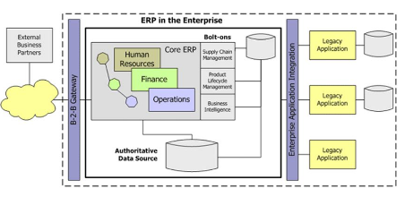
Architectural Concepts
Enterprise Resource Planning
1.1

Slide 7
Architectural Concepts
Web Integration
1.2
A Web-based application avoids many of the connectivity and compatibility problems that typically arise when different hardware environments are involved.
In a Web-based environment, a firm’s external business partners can use standard Web browsers to import and export data.

Slide 8
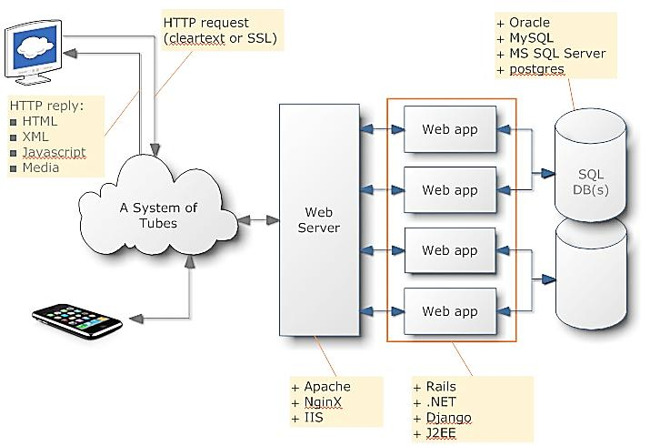
Architectural Concepts
Web Integration
1.2
Examples: facebook, e-commerce

Slide 9
Architectural Concepts
Processing Options
1.3
Online/Real time Processing and Batch processing
In planning the architecture, designers also must consider how the system will process data — online or in batches. For example, a high-capacity transaction processing system, such as an order entry system, requires more network, processing, and data storage resources than a monthly billing system that handles data in batches.
If the system must operate online, 24 hours a day and seven days a week (24/7), provision must be made for backup and speedy recovery in the event of system failure.

Slide 10
Total cost of Ownership
1.4
How will be the total cost, revision on TCO

Slide 11
Legacy System Interface requirements
1.5
A new marketing information system might need to report sales data to a server based on accounting system and obtain product cost which might be a part of a legacy system

Slide 12
Security Issues
1.6
Need to think about the urgency and severity of issues related with security
1.7
Scalability
Extensibility
Ability to expand, change or downsize easily to meet the changing needs.
Handling the traffic from couple of nodes to hundreds of thousands of nodes

Slide 13
Planning the Architecture
Planning the Architecture
2.0
Server
A server is a computer that supplies data, processing services, or other support to one or more computers, called clients
Client
A client is a computer that requests data, processing services or other support from computers called servers
Network
A medium/way through which clients and servers communicate with each other
Web Server, Database Server
Stand Alone, Thin Client, Thick client
Geographical division (LAN, WAN, MAN), connection style, Topologies
2.1
2.2
2.3

Slide 14
Common types of Servers
2.1.1
Types of Server
  Database Server
  Transaction Server
    The transaction server acts as an intermediary server that can ensure that the application or user receives the requested data from the database or the completion of that transaction. [Concept of distributed server system is involved]
    Makes distributed system possible
  Web Server
  Mail Server (outgoing mail server, incoming mail server)
  FTP Server
  Print Server
  Remote Access Server
Notes:
Database server: MySql, Microsoft sql server, MariaDB, Oracle
Transaction Server: Microsoft Server (Viper), Microsoft Transaction Server
Web server: Apache Server, Microsoft IIS Server, Nginx
Mail server: outgoing: SMTP, Incoming: POP3, IMAP (store message)
FTP: Filezilla, Transmit

Slide 15
Additional information on SERVER
2.1.2
Some extra information about SERVER
  Xeon Processor are standard processor used in server (opposed to I7)
  Equipped with Redundant power supply
  Equipped with RAID – Disks
  Equipped with ECC RAM (Self testing and self healing)

Slide 16
Clients: Types of Clients
2.2
Pre-requisite: concept of layers [ Database – Application – User Interface ]
Types of Client/Server Network
  Thick Client:
  - Server: Story only data
  - Client:
  + hold software, all the processing happens in client
  + Client need to be powerful in order to process
  - Bandwidth: Need high between client and server
  Thin Client:
  - Server: hold software as well as data and processing is done by server itself.
  - Client: will only have interface to access the application and data stored in server
  - Bandwidth: low bandwidth can cope between client and server
Diagram
Notes:
- Draw diagram to teach

Slide 17
Local Area Network (LAN)
Network
2.3
On the basis of Geographical Division
2.3.1
2.3.2.1
Connect computers and other devices within limited physical area, e.g. office, classroom, building

Slide 18
Metropolitan Area Network (MAN)
2.3.1.2
Inter-networking of local area networks (LANs)
It is a wide area network optimized a specific geographical area (a specific city or a metropolitan)
The networks can range from several blocks of buildings to entire cities
Local cable operators and Local telephone operator work within MAN

Slide 19
WAN – Wide Area Network
2.3.1.3
Wide Area Networks (WANs) are telecommunication networks covering a large geographical area, e.g. a large city or metropolitan area
Used by multinational companies, and organizations

Slide 20
Network Topologies
2.3.3
Three basic topologies used in WANs and LANs
  Star Topology:
  - Ties to a central computer (centralized approach)
  Ring Topology:
  - Ties to adjacent computer (decentralized approach)
  Bus Topology:
  - local computers share the same communication channel (decentralized approach)
Wired networks normally use a combination of network topologies
Different topologies networks differ in performance, reliability and costs.

Slide 21
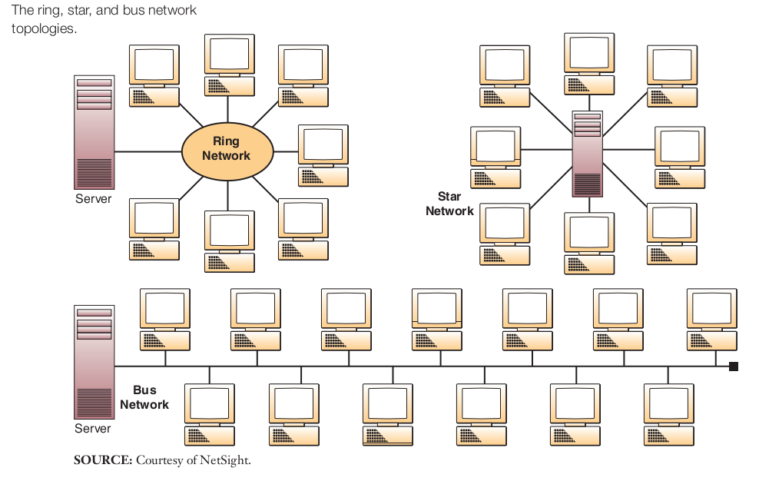
Network Topologies
2.3.3

Slide 22
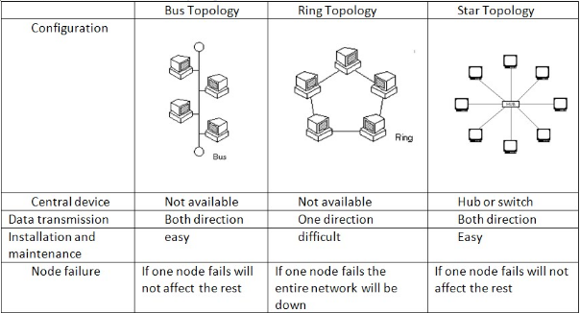
System Architecture
Topologies
2.3.3

Slide 23
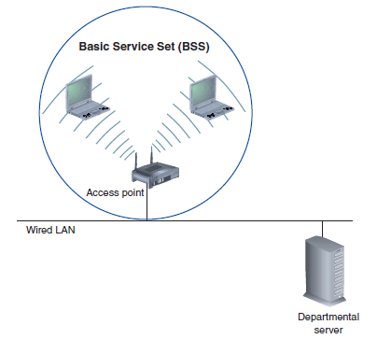
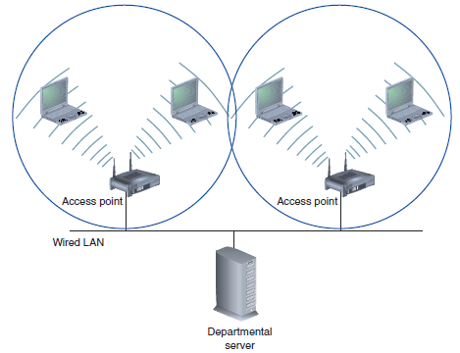
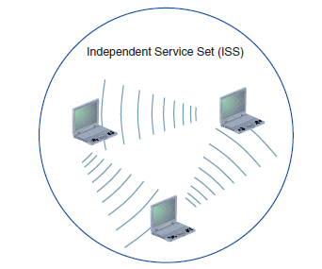
System Architecture
Wireless Topologies
2.3.3
Basic Service Set
Extended Service Set
Independent Service Set

Slide 24
WAIIIIIT… and THINK !
(LAN, WAN, MAN) and now (Star, BUS, Ring) ??
What’s the difference…

Slide 25
Client/Server Architecture
3.0
Distributed System
  Thin clients
  - [Application presentation layer / interface only]
  - [DBMS]
  Application Server
  - [Provides Applets, API based]
  Database Server
  - Databases
  - Data Warehouse

Slide 26
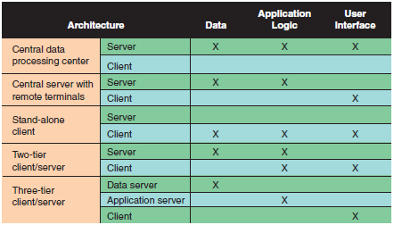
System Architecture
Variant of Client/Server Architecture (Tiers or Layers)
4.2

